Slide 1
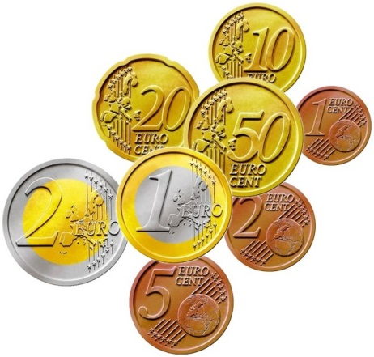
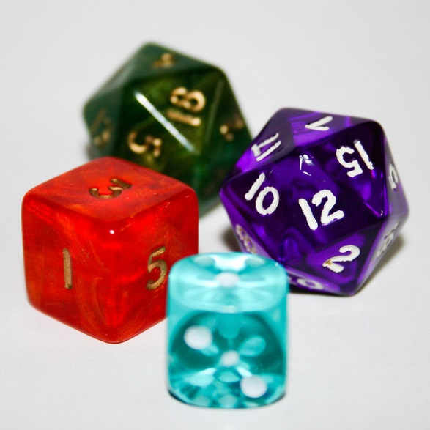
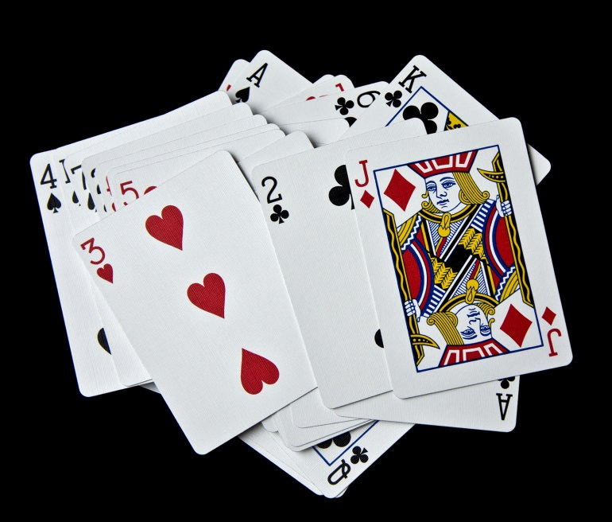
My Probability Interactive Notebook
Name
Class
Teacher Mr Evans
Term 2 Semester 1
1

Slide 2
Create your own front page
It needs to contain the following –
My number interactive notebook
Name
Class
Teachers Name
Semester 1 Term 1
Page number 1

Slide 3
Contents
Glossary or Formula Page
Page
Date
Description
2
3

Slide 4
Tasks
24
7
30
Essential Question
Questions
Notes
Summary
4
5

Slide 5
24
7
30
Date
Two Way Tables
EQ – When and why do we use 2 way tables?
Revision: Not for Notes.
When is it appropriate to use a 2 way table?
Two way tables are useful for situations that have two dimensions or two variables.
5

Slide 6
24
7
30
Date
Two Way Tables
EQ – When and why do we use 2 way tables?
Revision: Not for Notes.
When is it appropriate to use a 2 way table?
Two way tables are useful for situations that have two dimensions or two variables.
Example
Emma has collected information about the cats and dogs that children in her class have as pets. There are 30 pupils. For each pupil, there are four possible responses they could make:
The pupil has a cat and a dog.
The pupil has a cat but not a dog.
The pupil has a dog but not a cat.
The pupil does not have a cat or a dog.
This information can be represented in the table below.
5

Slide 7
24
7
30
Date
Two Way Tables
EQ – When and why do we use 2 way tables?
Revision: Not for Notes.
Two way tables are useful for situations that have two dimensions or two variables.
When is it appropriate to use a 2 way table?
Example
Emma has collected information about the cats and dogs that children in her class have as pets. There are 30 pupils. For each pupil, there are four possible responses they could make:
The pupil has a cat and a dog.
The pupil has a cat but not a dog.
The pupil has a dog but not a cat.
The pupil does not have a cat or a dog.
This information can be represented in the table below.
 | Has a dog | Does not have a dog
Has a cat | These pupils have both a cat and a dog | These pupils have a cat but not a dog
Does not have a cat | These pupils have a dog but not a cat | These pupils do not have a cat or a dog
5

Slide 8
24
7
30
Date
Two Way Tables
EQ – When and why do we use 2 way tables?
Revision: Not for Notes.
When is it appropriate to use a 2 way table?
When Emma has entered some of her data, the table looks like this:
 | Has a dog | Does not have a dog
Has a cat | 8 | 4
Does not have a cat | 12
Emma has missed out one of the numbers, but we know that there are 30 pupils in her class.
5

Slide 9
24
7
30
Date
Two Way Tables
EQ – When and why do we use 2 way tables?
Revision: Not for Notes.
When is it appropriate to use a 2 way table?
When Emma has entered some of her data, the table looks like this:
 | Has a dog | Does not have a dog
Has a cat | 8 | 4
Does not have a cat | 12
Emma has missed out one of the numbers, but we know that there are 30 pupils in her class.
How many pupils do not have a cat or a dog?
How many pupils have a dog?
How many pupils have a cat?
How many pupils have at least one of these pets?
5

Slide 10
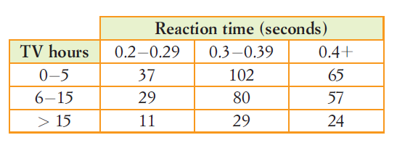
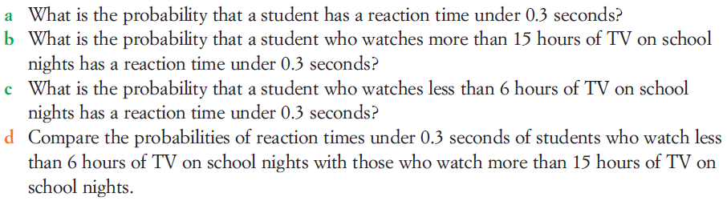
24
7
30
Date
Two Way Tables
EQ – When and why do we use 2 way tables?
How do I calculate probability from a two way table?
The information below measures reaction times and the time (in hours) students said they spent watching tv on school nights.
5

Slide 11
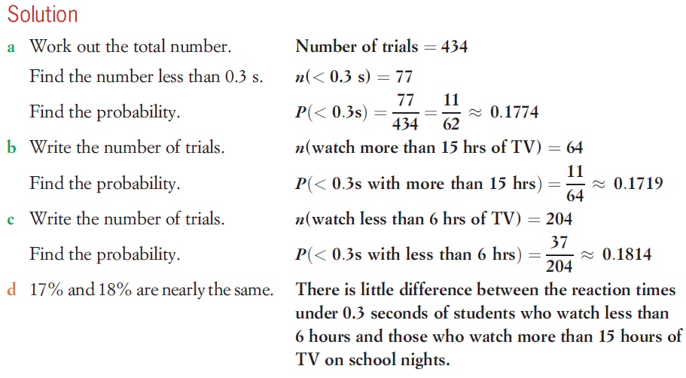
24
7
30
Date
Two Way Tables
EQ – When and why do we use 2 way tables?
How do I calculate probability from a two way table?
5

Slide 12
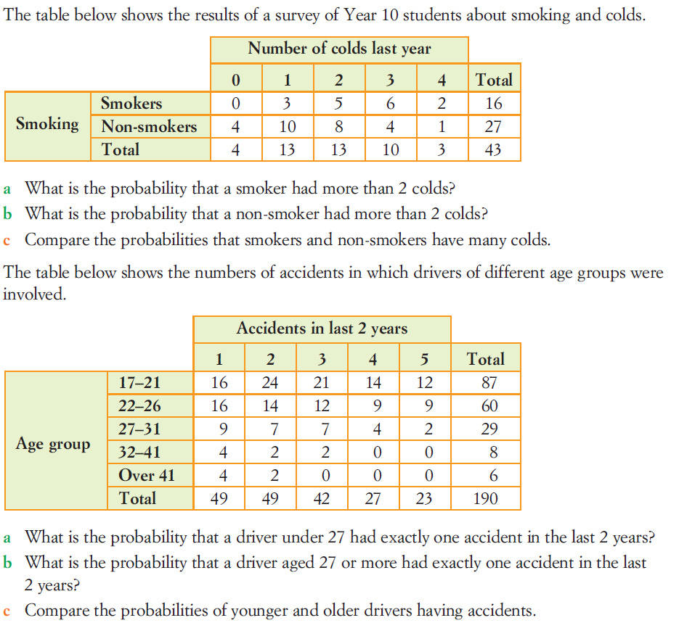
Task

Slide 13
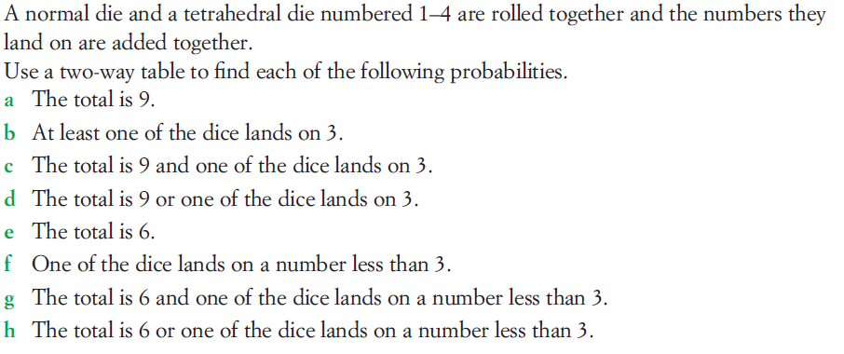
Task

Slide 14
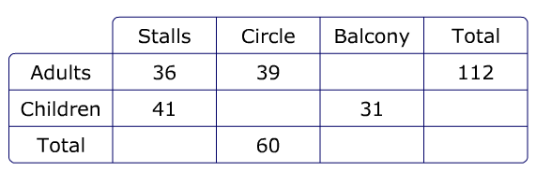
Probability from two way tables
1. The two way table shows the distribution of members of the audience at a play.
(a) Complete the two way table
(b) What is the probability that a randomly chosen audience member is an adult and is seated on the balcony?
(c) What is the probability that a randomly chosen audience member is a child seated in the circle?
(d) What is the probability that a randomly chosen audience member is an adult?
(e) What is the probability that a randomly chosen audience member is sat on the balcony?
(f) What is the probability that a randomly chosen audience member is seated in the stalls?
(e) What is the probability that a randomly chosen audience member is a child?

Slide 15
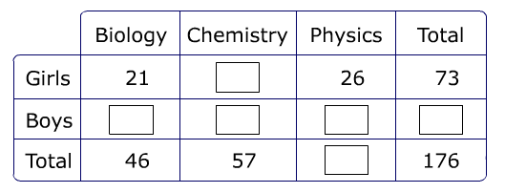
2. The two way table shows which science some students prefer.
(a) Complete the two way table
(b) What is the probability that a randomly chosen student is a girl who prefers biology?
(c) What is the probability that a randomly chosen student is a boy who prefers physics?
(d) What is the probability that a randomly chosen student is a boy who prefers biology?
(e) What is the probability that a randomly chosen student is a boy?
(f) What is the probability that a randomly chosen student prefers biology?
(e) What is the probability that a randomly chosen student prefers physics?

Slide 16
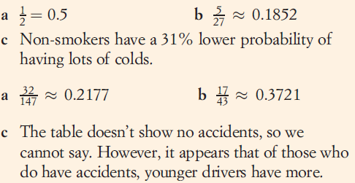
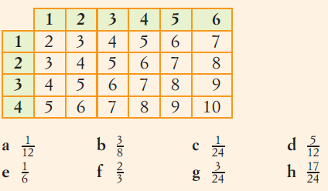
Answers

Slide 17
Notes Review
24, 7 ,30
Date
Title
Essential question
Notes complete
Notes complete with colour and diagrams
Questions completed
Contents page filed in
Formula page filled in

Slide 18
Homework
Review your notes and write a summary answering the essential question.

